Slide 1
Color Palette Detection
CARDINALS

Slide 2
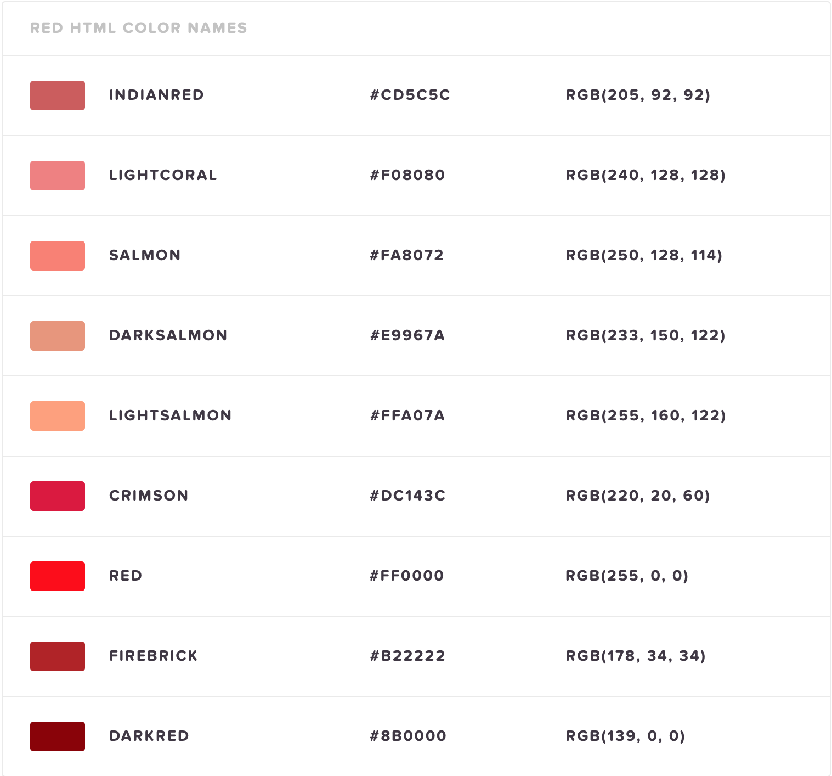
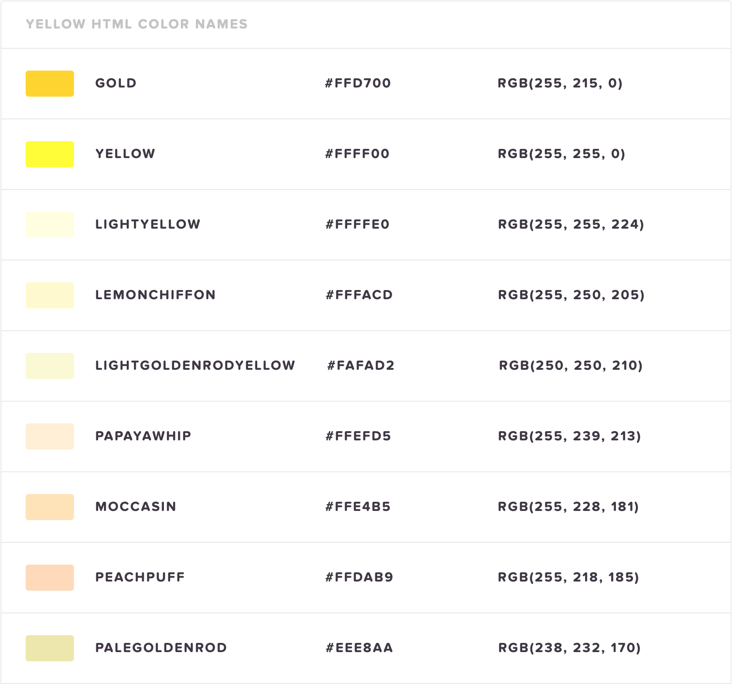
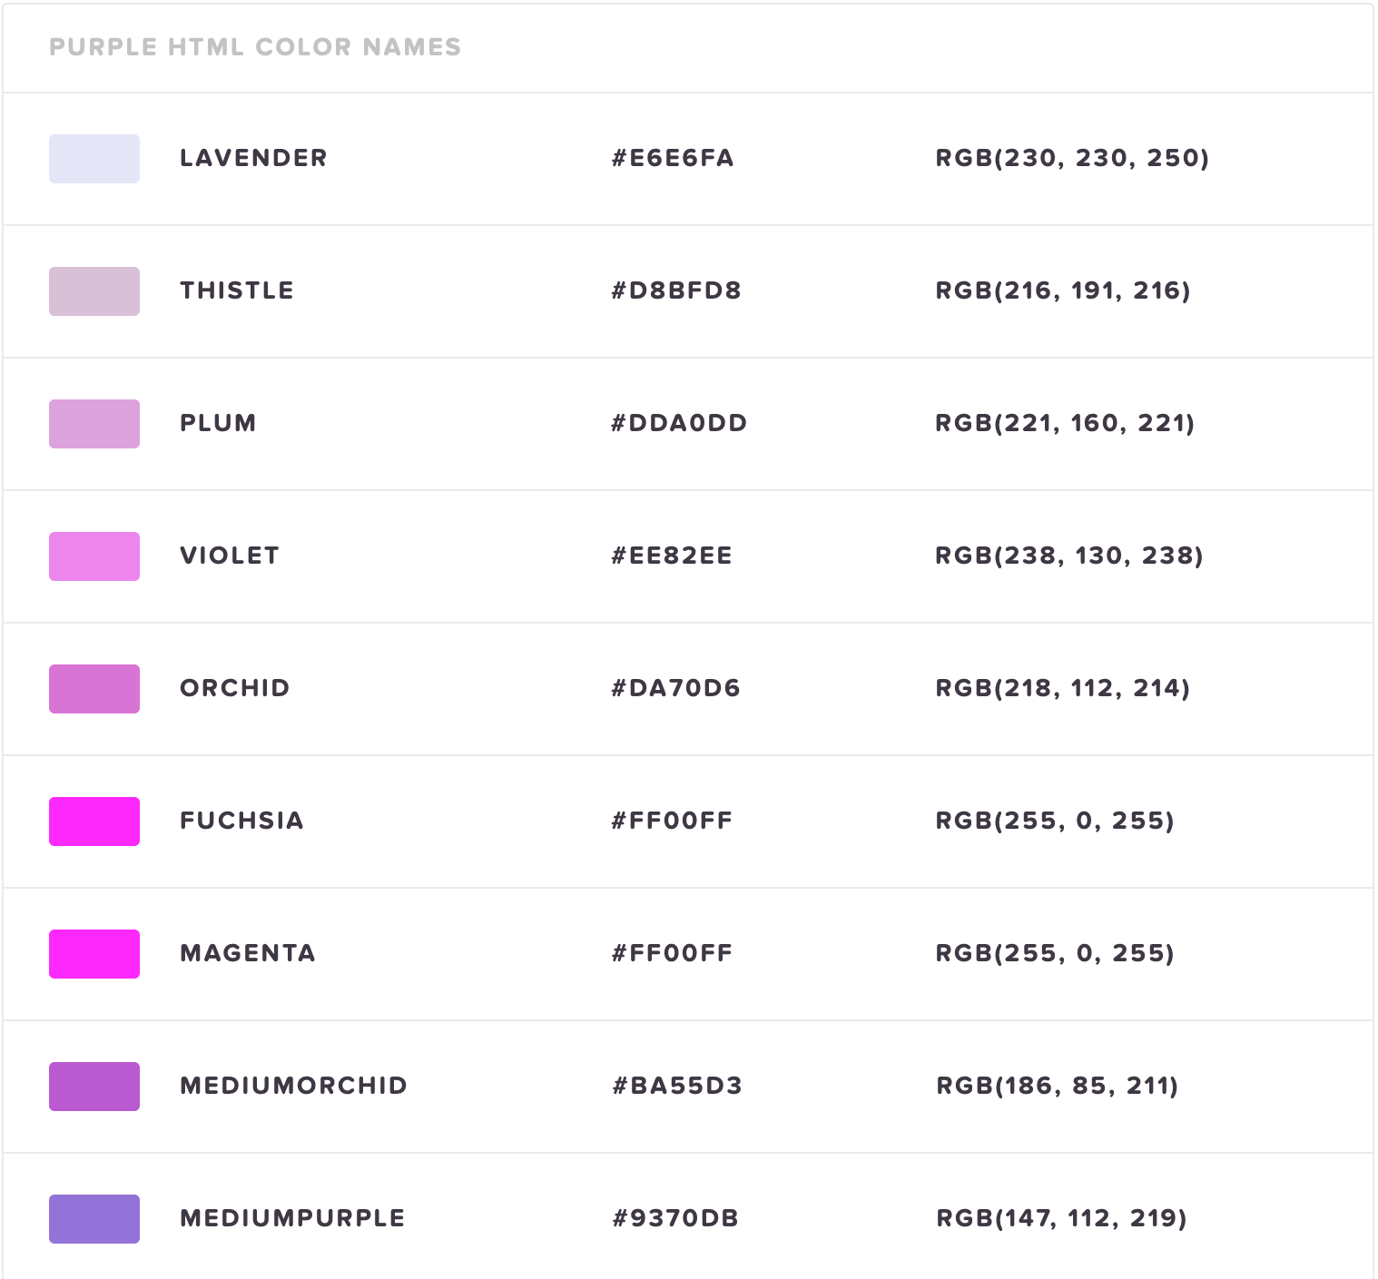
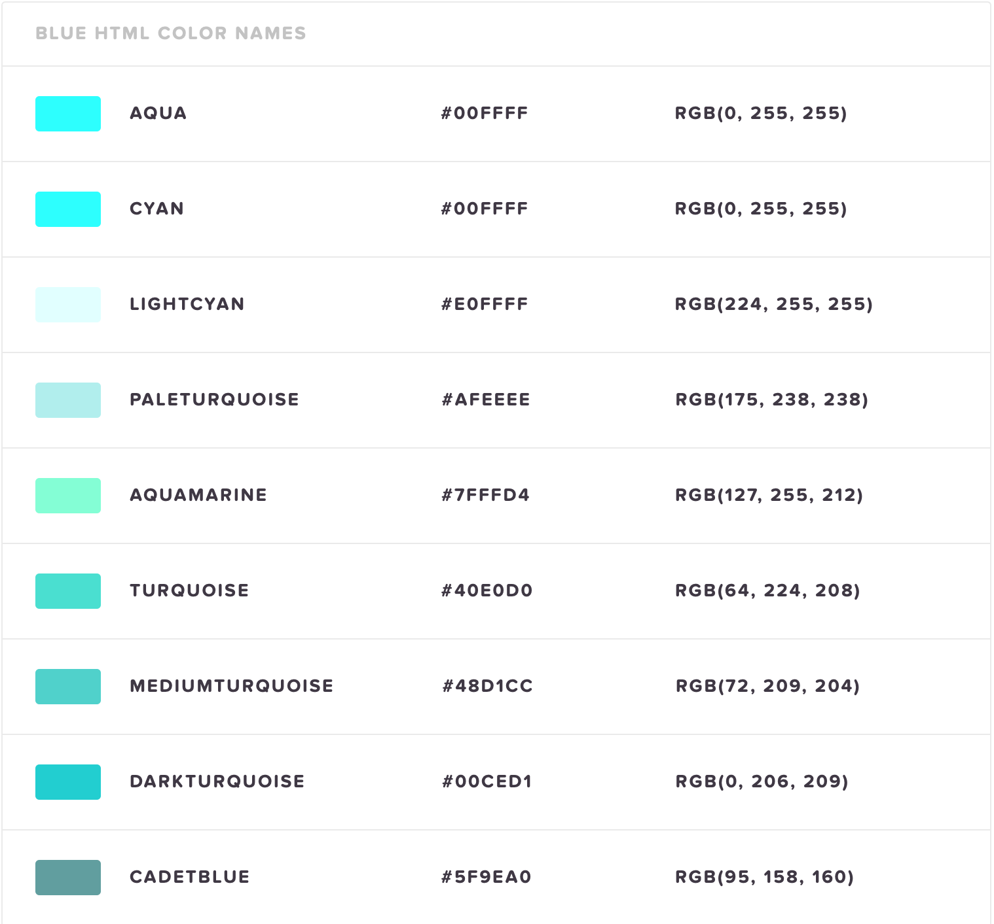
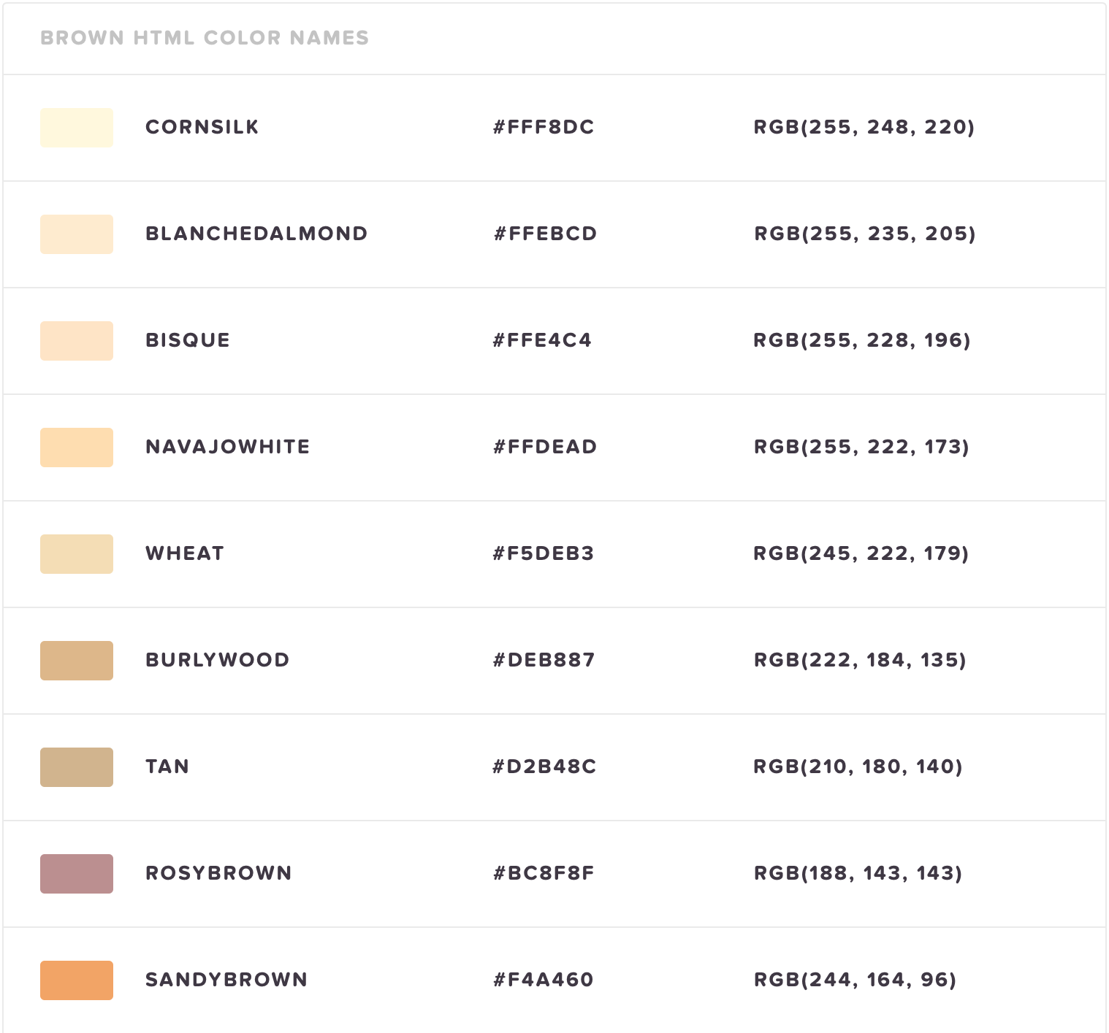
Introduction
Predefined Color Palette (143 colors)
Traditional (exact BGR)

Slide 3
Previous Implementations
HTML/CSS (original) - developed by Lokesh Dhakar
Java - developed by Sven Woltmann
Rust - developed by Evgeniy Reizner
Swift - developed by Kazuki Ohara
NO PARALLELIZATION

Slide 4

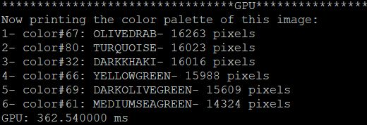
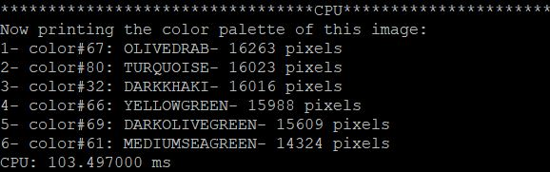
Trial # 1
Test image 1: JPG 700x140 px
Output: GPU
Output: CPU

Slide 5
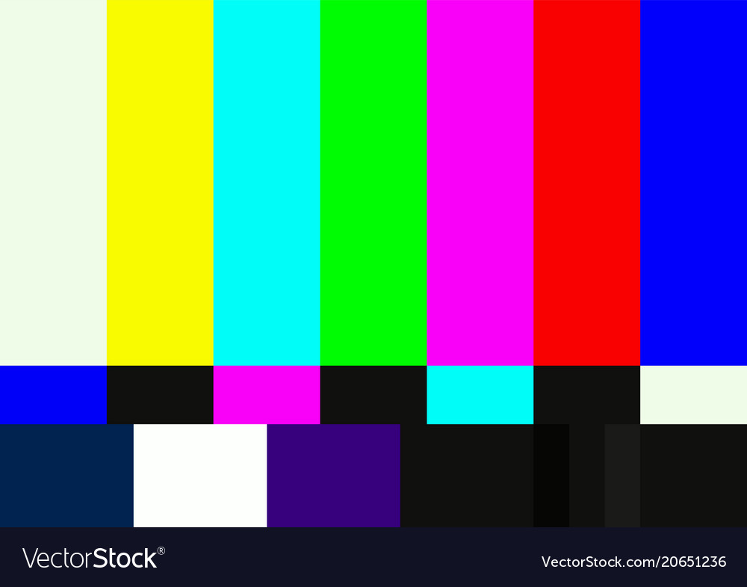
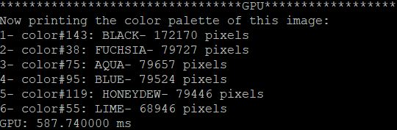
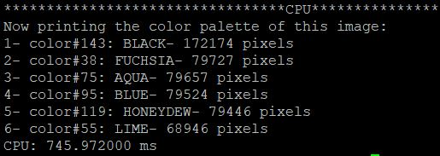
Trial # 2
Test image 2: JPG 1000x786 px
Output: GPU
Output: CPU

Slide 6

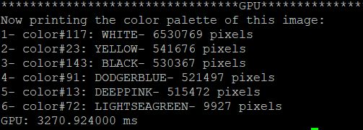
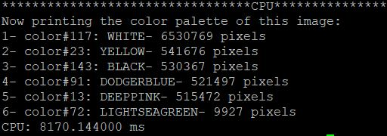
Trial # 3
Test image 3: JPG 2480x3508 px
Output: GPU
Output: CPU

Slide 7
Parallelizing
We will now demonstrate our
linear vs. parallelized code!

Slide 8
Thank you for your time!

